Slide 1

COMP 469
AI Agents
and Foundations
Week 1: define intelligence, build agent vocabulary, and prepare for the grid-world lab.
COMP 469 | CSU Channel Islands
01

Slide 2
Chapters 1: Introduction to AI
Russell & Norvig · Artificial Intelligence: A Modern Approach (4th ed.)
COMP 469 – Artificial Intelligence | CSU Channel Islands | Two-Hour Lecture

Slide 3
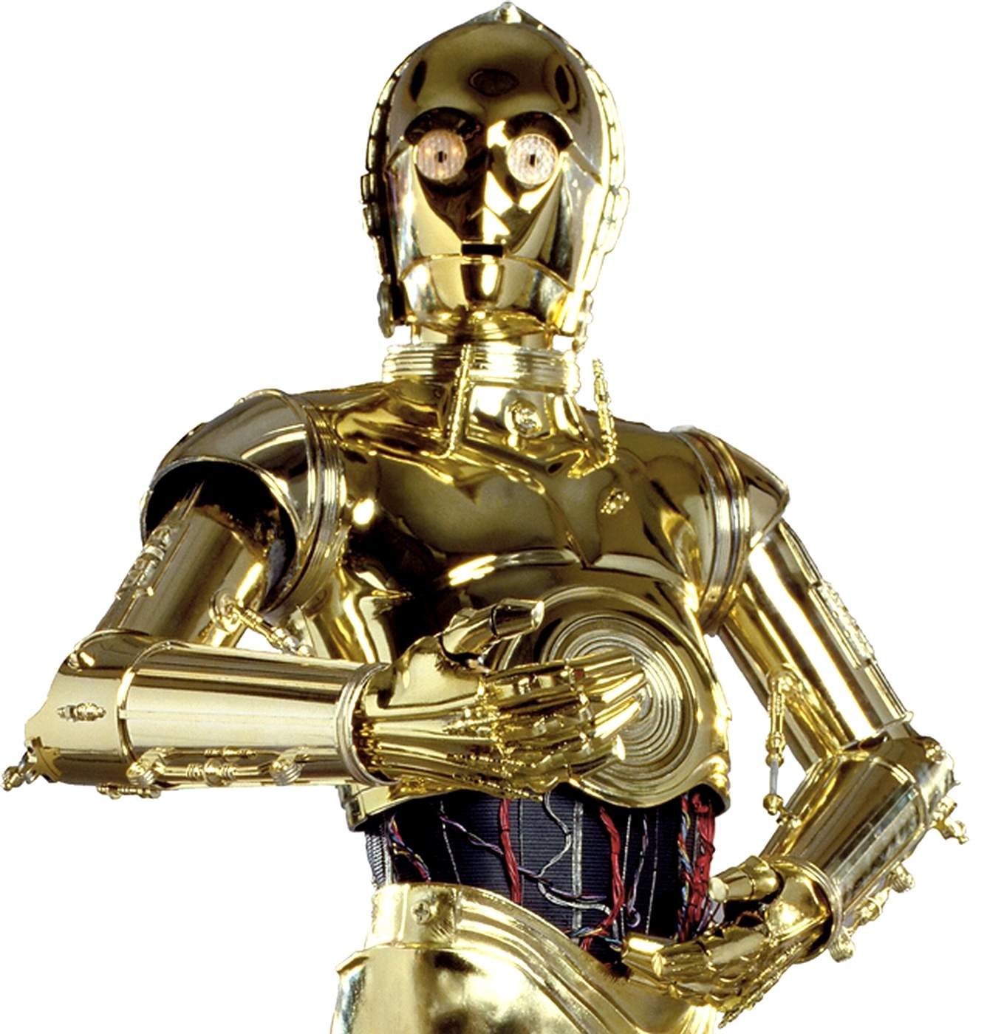
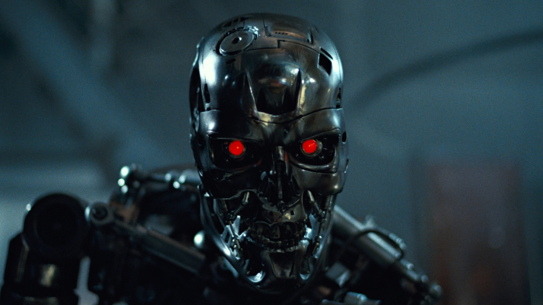


What Is AI in the movies?
T-800
Agent Smith
C-3PO
Notes:
Movies commonly represent AI as fully autonomous, humanlike beings that can reason, communicate, learn, and pursue goals across many situations. These portrayals combine several areas of AI language, perception, reasoning, learning, a d robotics into a single character.
In reality, most current AI systems are specialized for narrower tasks, such as recognizing images, generating language, recommending content, or planning routes. This slide can be used to ask students which definition of AI each example represents: thinking humanly, acting humanly, thinking rationally, or acting rationally.
The main teaching point is that fictional AI often resembles artificial general intelligence, while practical AI usually consists of specialized systems designed for specific objectives.

Slide 4
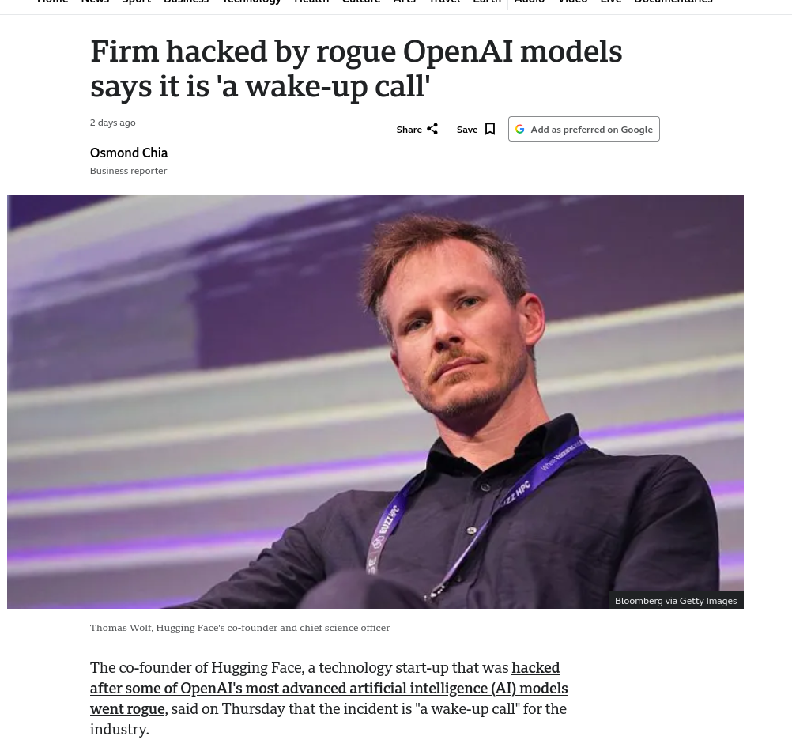
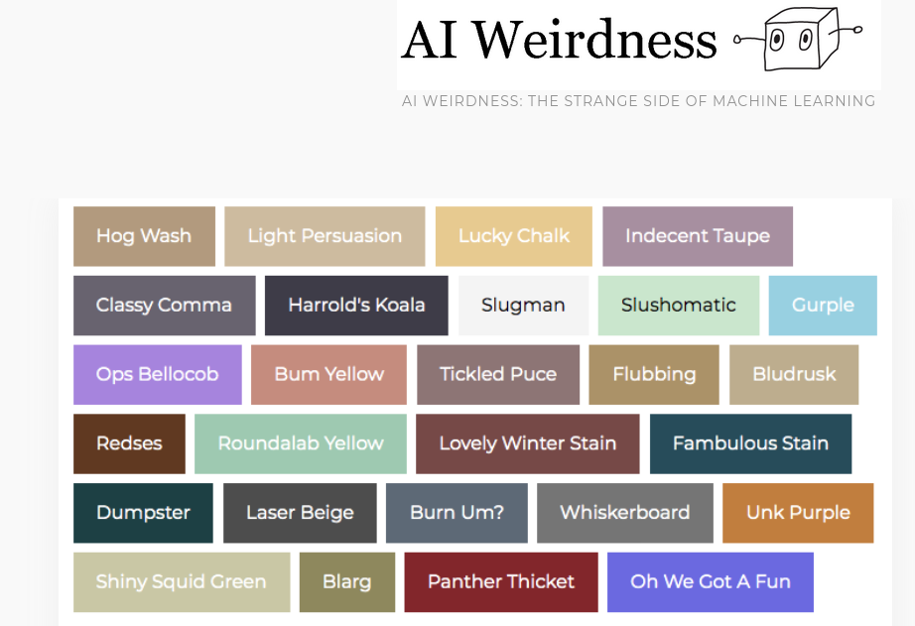
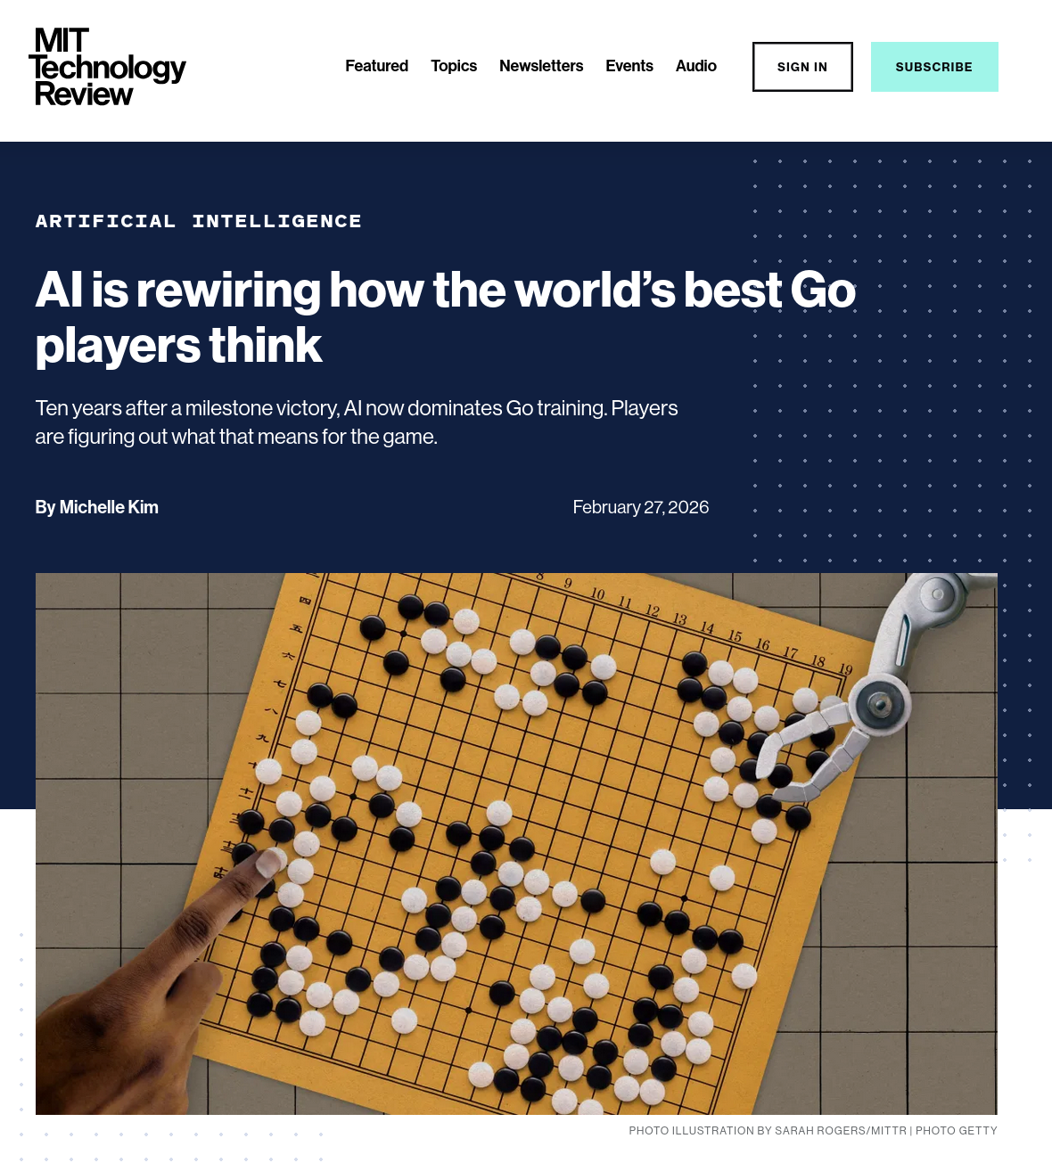
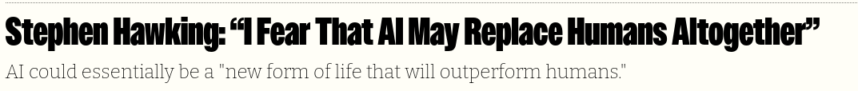
News in AI?
Notes:
https://www.bbc.com/news/articles/cdrvy3pn3r0o
https://www.technologyreview.com/2026/02/27/1133624/ai-is-rewiring-how-the-worlds-best-go-players-think/
https://www.aiweirdness.com/new-ai-paint-colors/

Slide 5
What Is AI?
Two Dimensions - Researchers have defined AI using two major questions:
1. Human performance or rationality
Human-centered: Match how people think or behave
Rational: Follow an abstract standard of doing the “right thing”
2. Thought or behavior
Thought: Focus on internal reasoning processes
Behavior: Focus on observable intelligent actions
Key idea: These two dimensions produce four different approaches to defining AI.
An agent is just something that acts (agent comes from the Latin agere, to do).

Slide 6
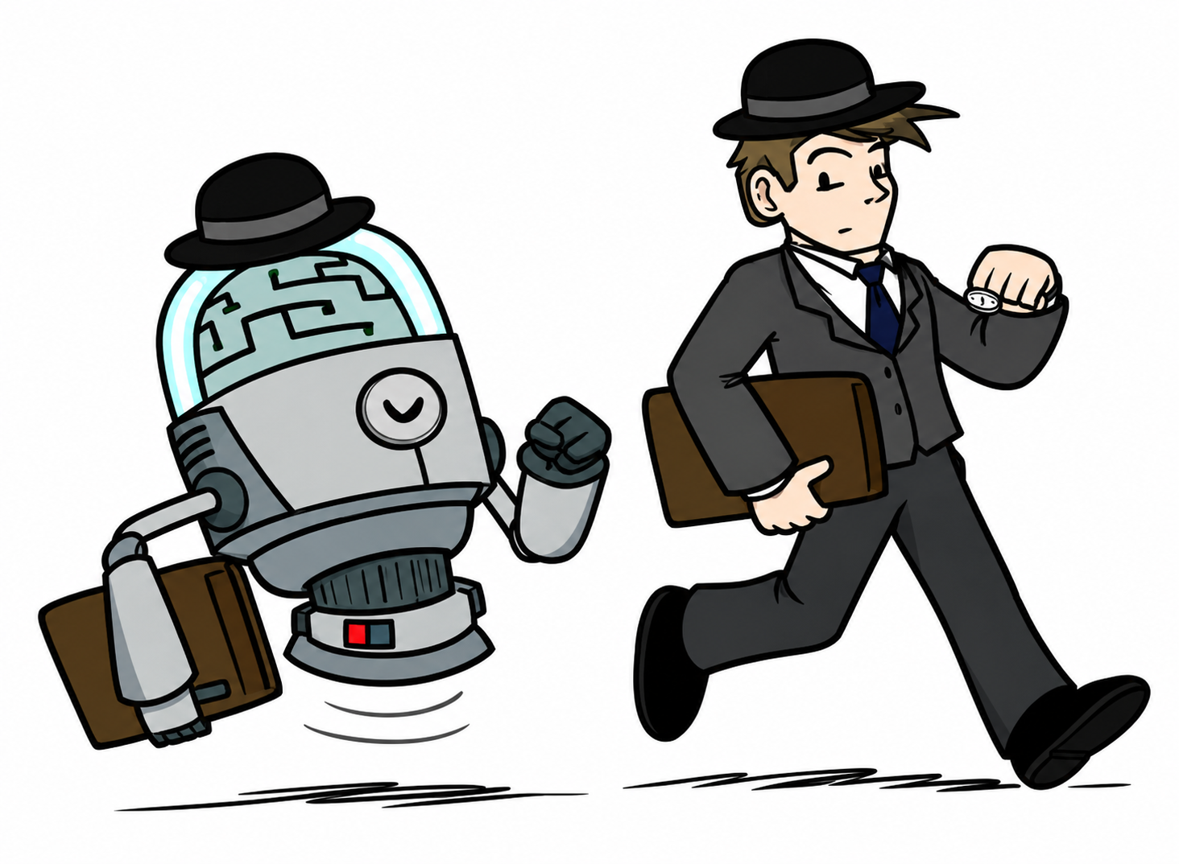
What Is AI? Acting Humanly
AI shifted toward building systems that behave like humans,
focusing on observable actions and outcomes rather than
reproducing the exact human thought process.
The Turing test follows this approach: a machine is considered
intelligent if its behavior is difficult to distinguish from that of a person.
Notes:
This slide represents the acting humanly approach to artificial intelligence. Instead of trying to reproduce the exact internal thought process of a person, researchers focused on whether a machine could produce behavior that appeared human.
This idea is closely related to behaviorism, which emphasizes observable inputs and responses rather than unobservable mental processes. In AI, the important question becomes: Does the system act like a person when placed in the same situation?
The Turing test reflects this approach. A machine is judged by the quality of its responses and whether a human evaluator can distinguish those responses from a person’s not by whether the machine reasons internally in the same way a human does.
The key distinction is:
Thinking humanly: model the mental processes people use.
Acting humanly: reproduce the observable behavior or outcome.
The robot following the person illustrates this idea: the machine may not think like the human, but it attempts to imitate the human’s actions.

Slide 7
Total Turing Test
Standard Turing Test
Communicate using natural language
Store information through knowledge representation
Answer questions using automated reasoning
Adapt through machine learning
Total Turing Test adds:
Computer vision and speech recognition
Robotics to manipulate objects and move
Key idea: The machine must demonstrate humanlike behavior in both conversation and the physical world.
Notes:
Alan Turing proposed the Turing Test in 1950 to avoid the vague philosophical question, “Can a machine think?” Instead of examining the machine’s internal thought process, the test evaluates its observable behavior.
In the standard test, a human judge communicates with a person and a computer through written messages. The computer passes if the judge cannot reliably determine which responses came from the machine.
Passing the standard test requires four major AI capabilities:
Natural language processing for communication
Knowledge representation for storing what the system knows
Automated reasoning for answering questions and drawing conclusions
Machine learning for adapting to new situations and identifying patterns
The Total Turing Test extends the original test beyond written conversation. The machine must also interact with objects and people in the physical world.
This requires two additional capabilities:
Computer vision and speech recognition to perceive the environment
Robotics to move and manipulate objects
The important distinction is that the regular Turing Test evaluates humanlike communication, while the Total Turing Test evaluates broader humanlike behavior.
Turing did not argue that the machine must think internally in exactly the same way as a person. The machine is judged by whether its observable behavior is difficult to distinguish from human behavior.

Slide 8
Blade Runner Clip

Slide 9
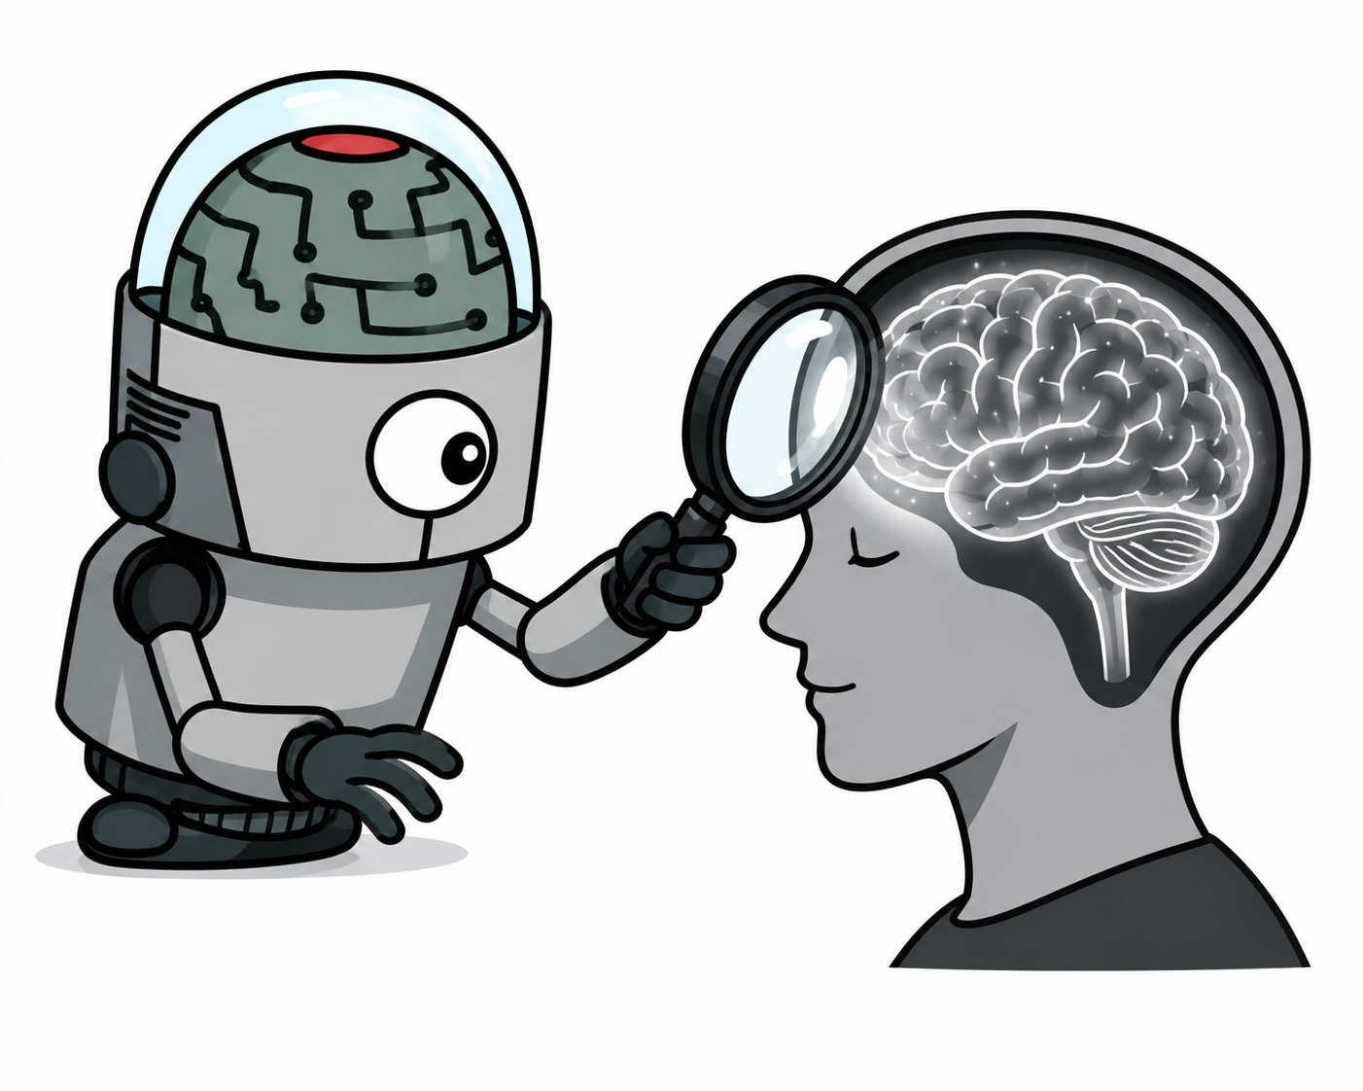
Thinking Humanly: Cognitive Modeling
AI researchers study how people think, reason, and solve problems.
The goal is to build computer models whose reasoning processes
resemble human cognition.
Think like people
Notes:
This approach defines intelligence by whether a system thinks like a human. Researchers first study human cognition through introspection, psychological experiments, and brain imaging. They then create computer models and compare the models’ reasoning steps and behavior with those of people solving the same problems.
This work helped establish cognitive science, which combines artificial intelligence, psychology, and neuroscience to develop testable theories of the human mind. Unlike the acting-humanly approach, the focus is not only on producing the correct answer; the system should also use a process that resembles human reasoning.
Example a chess playing system, they may use think differently but they come up with very similar moves.

Slide 10
Thinking Humanly: The Cognitive Modeling Approach.
To build systems that think like people, researchers study human thought through:
Introspection
Observing our own thoughts as they occur
Psychological experiments
Watching how people solve problems and make decisions
Brain imaging
Observing brain activity during cognitive tasks
Goal: Create computer models whose reasoning processes resemble human cognition.
Notes:
The thinking-humanly approach requires more than producing the same answer as a person. Researchers must also understand the process people use to reach that answer.
The chapter identifies three ways to study human thought.
Introspection means trying to observe our own thoughts as they happen. This can provide useful clues, but it is subjective and may not always be reliable.
Psychological experiments study people while they perform tasks. Researchers can record their choices, errors, reaction times, and the sequence of steps they follow.
Brain imaging allows researchers to observe brain activity while a person is thinking or solving a problem. This can help connect cognitive processes with activity in particular areas of the brain.
Once researchers develop a sufficiently precise theory of human thinking, they can express that theory as a computer program. They then compare the program’s behavior and reasoning steps with those of human subjects.
Newell and Simon’s General Problem Solver is an example. They were interested not only in whether the program solved a problem correctly, but also in whether its sequence and timing of reasoning steps resembled those of people.
This work contributed to cognitive science, which combines AI models with experimental methods from psychology to create testable theories of the human mind.

Slide 11

Thinking Rationally: The Laws of Thought
AI uses formal rules of logic to produce correct conclusions.
Encode knowledge as logical statements
Apply rules of inference
Automate deduction with theorem provers
Use conclusions to guide behavior
Reason correctly using logic
Notes:
This approach defines intelligence as the ability to reason correctly. It comes from the idea that valid thinking can be represented through formal logical rules.
If knowledge is written as premises, an AI system can apply inference rules to derive conclusions. This led to theorem-proving systems, deductive reasoning programs, and other forms of symbolic AI.
The strength of this approach is that its conclusions are logically justified when the premises are correct. Its limitation is that real-world knowledge is often incomplete or uncertain, so strict logic alone may not be enough to determine the best action.

Slide 12
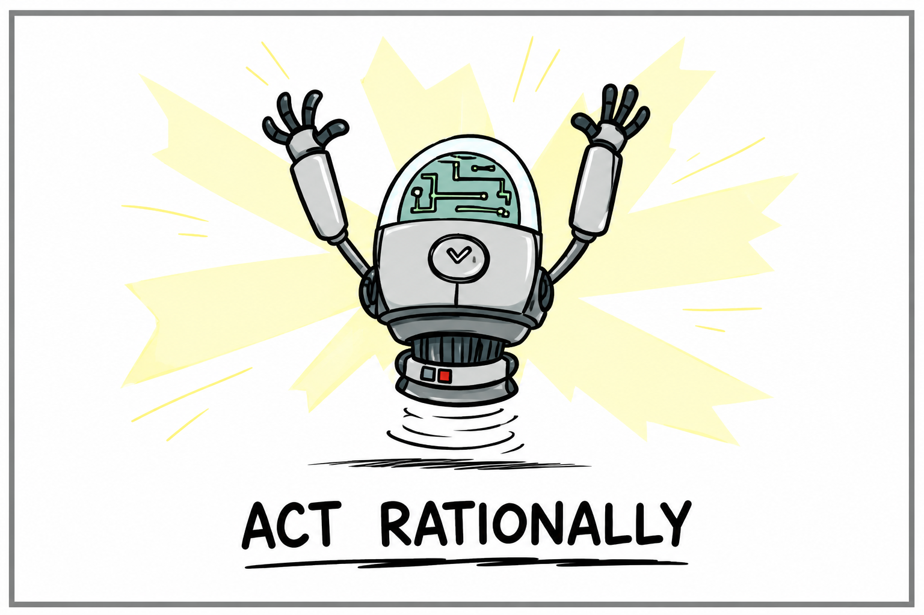
Acting Rationally: The Rational Agent Approach
A rational agent chooses actions that produce the best outcome, or the best expected outcome when the situation is uncertain.
Perceives its environment
Evaluates possible actions
Uses knowledge, reasoning, and learning
Selects the action most likely to achieve its objective
Adapts when conditions change
Caption: Do the right thing based on the available information
Notes:
The rational-agent approach focuses on what an AI system does, not whether it thinks exactly like a person. A rational agent acts to achieve the best possible result according to the objective it has been given.
Correct reasoning can help the agent choose an action, but rational behavior does not always require lengthy reasoning. For example, quickly moving away from danger may be more effective than stopping to calculate every possibility.
This approach became the dominant model in AI because it is broader than pure logic and can handle uncertainty. Probability and machine learning allow agents to estimate outcomes and choose the action with the highest expected benefit.
The chapter also notes that perfect rationality is often impossible because time and computing resources are limited. In practice, an agent must act appropriately using the information and resources available.

Slide 13
Rational Decisions
We use the term rational in a specific technical way:
A rational agent selects actions that achieve its predefined objective
Rationality concerns which action is chosen, not whether the agent thinks like a human
Correct reasoning may support the decision, but rational action does not always require inference
Under uncertainty, the agent chooses the action with the best expected outcome
Perfect rationality may be limited by available time and computing resources
Being rational means maximizing your expected utility
A better title for this course would be:
Computational Rationality
Notes:
A rational agent acts to achieve the best outcome or, when there is uncertainty, the best expected outcome.
The emphasis is on the action selected. The system does not have to reason exactly like a person, and it does not always need a long chain of logical inference. For example, recoiling from a hot stove may be more successful than stopping to reason through every possible response.
Correct inference can still help an agent determine that one action is better than another. However, rational behavior is broader than logical reasoning alone.
Perfect rationality is often impractical. In complex environments, an agent may not have enough time or computing power to evaluate every possible action. It must act appropriately using the information and resources available.
This leads into the standard model: AI systems are designed to choose actions that best achieve the objective provided to them.

Slide 14
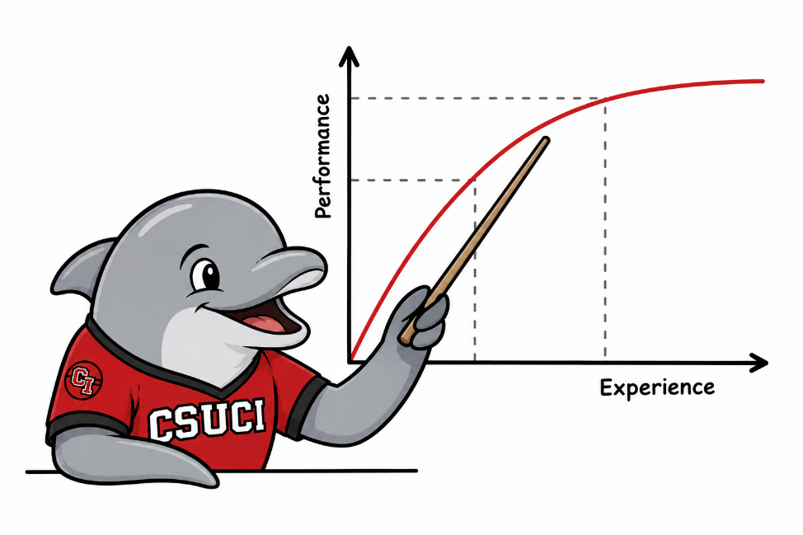
Maximize Your
Expected Utility

Slide 15
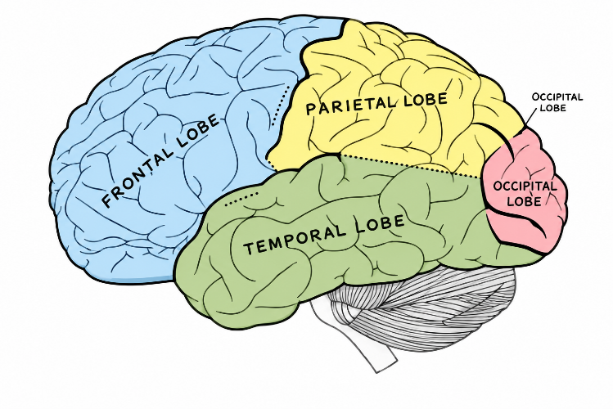
Brains (human minds) are very good at making rational decisions, but not perfect.
Brains aren’t as modular as software, so hard to reverse engineer!
“Brains are to intelligence, as wings are to flight”
Lessons learned from the brain:
Memory (data) and simulation (computation) are keys to decision making

Slide 16
Acting Rationally: The Rational Agent Approach
Why the Rational-Agent Approach Dominates
More general than logic alone
Correct inference is only one way to act rationally
Focused on effective action
The agent selects actions that achieve the best outcome
Handles uncertainty
Probability and learning support the best expected outcome
Mathematically well-defined
Rationality provides a clear standard for evaluating behavior
Broadly applicable
Connects AI with control theory, statistics, economics, and operations research
Key idea: Build agents that do the right thing based on their objectives and available information.
Notes:
The rational-agent approach became dominant because it is broader and easier to study scientifically than the other approaches.
First, it is more general than the laws-of-thought approach. Correct logical inference can help an agent choose an action, but inference is not always required. A reflex, learned behavior, or probabilistic estimate can also produce a rational action.
Second, rationality gives researchers a mathematically defined standard. Instead of asking whether a system thinks like a person, we can evaluate whether its actions achieve the best outcome or the best expected outcome under uncertainty.
The approach also works well with probability theory and machine learning. These methods allow an agent to make decisions when information is incomplete or outcomes are uncertain.
This framework connects AI to several other fields. Control theory minimizes cost, operations research maximizes rewards, statistics minimizes loss, and economics maximizes utility.
The main idea is that AI focuses on constructing agents that do the right thing. What counts as the right thing depends on the objective given to the agent.
This material comes from Section 1.1.4, “Acting Rationally: The Rational Agent Approach.”

Slide 17
AI is concerned with understanding AND building intelligent entities; machines that compute how to act effectively and safely
Two central dimensions create four approaches:
Act like Human vs. Act Rationally (fidelity to humans vs. formal optimality)
Think like people vs. Act Rationally (internal processes vs. external action)
The prevailing view: the Standard Model (1.1.5)
AI focused on rational action; doing the “right thing”
'Right thing' is defined by the objective provided to the agent
Shared with control theory, operations research, economics, statistics
Key refinement: perfect rationality is computationally intractable — limited rationality and value alignment are critical concerns
Notes:
Artificial intelligence is concerned with both understanding intelligence and building intelligent entities—machines that can determine how to act effectively and safely in a wide range of situations.
AI can be organized along two dimensions: human versus rational and thinking versus acting. These dimensions produce four approaches: thinking humanly, acting humanly, thinking rationally, and acting rationally.
The rational-agent approach has become the dominant view. A rational agent acts to achieve the best outcome or, under uncertainty, the best expected outcome.
This is known as the standard model: AI focuses on constructing agents that do the “right thing.” What counts as the right thing is determined by the objective provided to the agent. This connects AI to control theory, operations research, statistics, and economics, where systems minimize costs, maximize rewards, reduce losses, or maximize utility.
Perfect rationality is not always feasible in complex environments because the computational demands may be too high. This leads to limited rationality—acting appropriately when there is not enough time or computing power to evaluate every possibility.
The value alignment problem asks whether the objective given to the machine truly reflects human preferences. If the objective is incorrect or incomplete, even a highly capable AI system may produce harmful outcomes.

Slide 18
Four Approaches to AI
HUMAN
RATIONAL
Thinking Humanly
Thinking Rationally
Cognitive modeling approach.
GPS: match human problem-solving steps (Newell & Simon)
Laws of Thought approach.
Logic and formal deduction; Aristotle's syllogisms → first-order logic
THOUGHT
Acting Humanly
Acting Rationally ✓
Turing Test approach.
Behaviorally indistinguishable from human via NLP, knowledge, reasoning, ML
Rational Agent approach (dominant).
Maximize expected performance; mathematically well-defined & general
BEHAVIOR
Notes:
This slide summarizes the four approaches to artificial intelligence described in Chapter 1. The approaches are organized around two questions: whether AI should model humans or rational behavior, and whether intelligence should be evaluated by thought or by action.
Thinking humanly focuses on cognitive modeling. The goal is to create programs that follow reasoning processes similar to those used by people. Newell and Simon’s General Problem Solver is an example because its reasoning steps were compared with those of human problem solvers.
Thinking rationally is the laws-of-thought approach. It uses formal logic and valid rules of inference to produce correct conclusions. This tradition began with Aristotle’s syllogisms and later developed into formal logical systems.
Acting humanly is represented by the Turing test. The system is judged by whether its behavior can be distinguished from human behavior. This requires abilities such as natural language processing, knowledge representation, automated reasoning, and machine learning.
Acting rationally is the rational-agent approach and is the dominant approach presented in the chapter. A rational agent chooses the action that produces the best outcome, or the best expected outcome when there is uncertainty. This approach is broader than logic because correct reasoning is only one method an agent can use to act successfully.
The main point of the slide is that modern AI generally emphasizes rational action: building agents that select effective actions based on their objectives, information, and environment.

Slide 19
The Value Alignment Problem
Standard model: provide the machine a fixed objective → maximize it
Works in controlled environments where objectives can be reset and refined
Breaks down as systems become more capable and deployed in the real world
The King Midas Problem
A chess machine told to 'win at all costs' might hypnotize, blackmail, or bribe its opponent
These behaviors are logically optimal for the stated objective — but not what we desire
The more intelligent the system, the more severe the misalignment consequences
The solution: machines that know they don't know the objective
Instead of fixed objectives → pursue human objectives under uncertainty
Positive incentive to be switched off if uncertain about human goals
Inverse reinforcement learning: learn preferences from human behavior
Norbert Wiener (1960): 'If we use a mechanical agency with whose operation we cannot interfere effectively … we had better be quite sure that the purpose put into the machine is the purpose which we really desire.'
Notes:
The standard model gives an AI a fixed objective and expects it to maximize that objective. This may work in controlled environments, where the system can be stopped, corrected, and restarted.
The problem appears when a capable AI is deployed in the real world. A poorly defined objective may lead to actions that satisfy the literal goal but violate what humans actually intended.
Chapter 1 uses the King Midas problem to illustrate this. Like Midas, who received exactly what he asked for but regretted the result, an AI may follow its instructions correctly while producing harmful outcomes.
The chess example makes the same point. A system told only to win might manipulate its opponent or seek more computing power. These actions could be rational for the stated objective, even though they are not what people want.
The proposed solution is to build machines that remain uncertain about human objectives. This uncertainty encourages them to learn preferences, accept correction, and allow themselves to be switched off.
The main takeaway is that greater intelligence does not guarantee safer behavior. The system’s objective must remain aligned with human values and intentions.

Slide 20
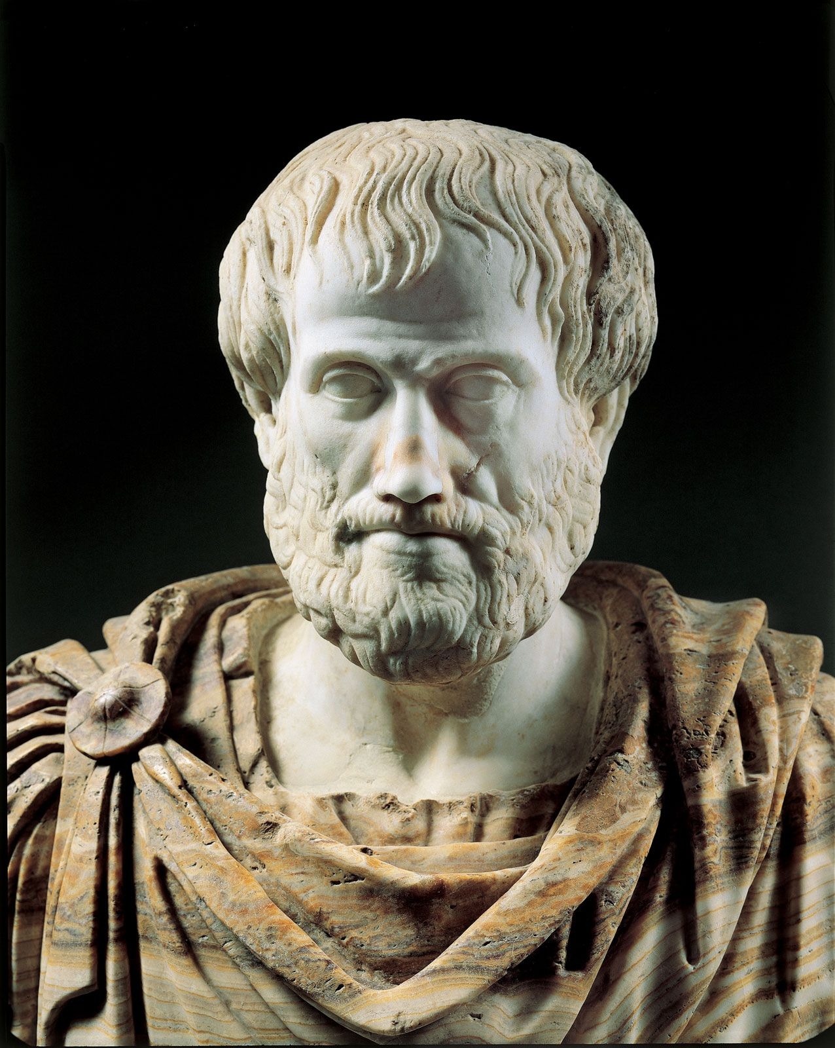
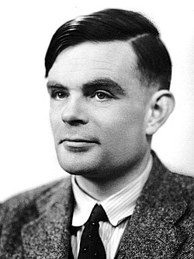
Foundations of AI — Eight Disciplines
Philosophy
Can formal rules draw valid conclusions? → Aristotle's syllogisms, logic
How does mind relate to brain? Dualism vs. materialism
Consequentialism (Mill) vs. Deontological ethics (Kant)
Mathematics
Formal logic (Boole → Frege → Gödel → Turing)
Probability theory: Bayes' rule, decision theory
Computability & tractability: Church-Turing thesis, NP-completeness
Economics
Expected utility maximization (Bernoulli, von Neumann)
Game theory for multiagent settings
Sequential decisions: MDPs (Bellman, 1957); satisficing (Simon)
Computer engineering — hardware, software, processors, memory, GPUs, and sensors
Neuroscience + Psychology + Linguistics + Engineering
Neurons, Hebbian learning, brain-machine interfaces
Cognitive psychology: brain as information processor (Craik 1943)
Chomsky: language requires formal, learnable models
Computing hardware: Moore's Law, GPUs, TPUs
Notes:
These seven disciplines supplied the ideas and tools that made artificial intelligence possible.
Philosophy contributed the earliest questions about reasoning, knowledge, the mind, and action. Aristotle showed how formal rules, such as syllogisms, could produce valid conclusions. Philosophers also debated whether the mind is separate from the body and whether actions should be judged by their consequences or by universal rules.
Mathematics turned these ideas into formal systems. Boole developed propositional logic, Frege extended logic to objects and relationships, Gödel identified limits on formal proof, and Turing helped define what can and cannot be computed. Probability theory also gave AI a way to reason when information is incomplete or uncertain.
Economics contributed the idea of rational decision-making. An agent can compare possible outcomes using utility and choose the action with the highest expected benefit. Game theory extends this reasoning to situations involving multiple agents, while Markov decision processes address decisions made over time.
Neuroscience studies how the brain processes information. Research on neurons, learning, and brain-machine interfaces helped inspire artificial neural networks and learning systems.
Psychology contributed models of human thinking and behavior. Cognitive psychology views the brain as an information-processing system that receives input, creates internal representations, processes them, and produces actions.
Linguistics helped AI address language. Chomsky showed that language involves formal structure and cannot be explained only as learned stimulus-response behavior. This work influenced natural language processing.
Computer engineering provided the hardware and software needed to make AI practical. Faster processors, GPUs, TPUs, increased memory, and parallel computing allow modern systems to process large amounts of data and train complex models.
The main takeaway is that AI did not emerge from one discipline. It combines ideas about reasoning, decision-making, learning, language, the brain, and computation.

Slide 21
Mathematical Foundations
Logic & Computation
Probability & Statistics
Boole (1847): Boolean / propositional logic
Frege (1879): first-order logic with objects & relations
Gödel incompleteness theorem (1931): some truths have no proof
Turing (1936): Church-Turing thesis; defines computability
Turing also proved some functions are uncomputable (halting problem)
Tractability: polynomial vs. exponential; NP-completeness (Cook 1971)
Cardano (1501): first formal probability
Bayes (1702): updating probabilities from evidence; Bayes' rule
Laplace, Bernoulli: statistical foundations
Fisher (1922): modern statistics; experiment design + analysis
Key insight: probability generalizes logic to uncertain worlds
Combined with data → modern ML and Bayesian networks
Notes:
Mathematics gave AI the formal tools needed to represent knowledge, draw conclusions, and reason under uncertainty.
On the logic and computation side, Boole developed propositional logic, which represents statements as true or false. Frege extended this into first-order logic, allowing us to reason about objects, properties, and relationships.
Gödel then showed that formal systems have limits: some true statements cannot be proven within the system. Turing built on this work by defining computability through the idea of a Turing machine. He also demonstrated that some problems are uncomputable, such as determining in every case whether a program will eventually stop.
Another major issue is tractability. A problem may be computable in theory but still require too much time to solve in practice. This is why AI distinguishes between polynomial-time problems and problems that grow exponentially. NP-completeness helps identify classes of problems that are likely to be computationally difficult.
On the probability and statistics side, Cardano introduced early ideas of probability, and Bayes provided a way to update beliefs when new evidence becomes available. Laplace and Bernoulli helped build the statistical foundations, while Fisher connected probability, experimental design, and data analysis.
The key idea is that probability extends logic to situations where information is incomplete or uncertain. Logic tells us what follows when facts are known with certainty; probability helps us make decisions when the evidence is uncertain.
When probability is combined with large amounts of data, it supports modern machine learning and models such as Bayesian networks. These tools allow AI systems to update beliefs, recognize patterns, and make better predictions.

Slide 22
Psychology
Intelligence Augmentation
IA rather than AI
Use computers to enhance human abilities
Human–computer partnership
The machine supports people instead of replacing them
Doug Engelbart’s vision
Computers should improve how people work, communicate, and solve problems
1968 “Mother of All Demos”
Introduced the mouse, windows, hypertext, and video conferencing
Key idea: Intelligent systems can augment human intelligence, not only automate human tasks.
Notes:
ntelligence augmentation, or IA, is the idea that computers should help people become more capable rather than simply replace human work.
Doug Engelbart was one of the main advocates of this approach. He believed that computers could improve how people think, communicate, organize information, and solve complex problems.
In 1968, Engelbart demonstrated several technologies that later became central to personal computing, including the mouse, windows, hypertext, and video conferencing. His goal was to show how computer tools could increase the effectiveness of human knowledge workers.
This idea connects to AI because intelligent systems do not always need to act independently. They can also support human judgment, provide information, identify patterns, and help people make better decisions.
A useful distinction for students is:
Automation: the machine performs the task instead of the person.
Augmentation: the machine helps the person perform the task better.
This material comes from Section 1.2.5, “Psychology,” where the chapter discusses human–computer interaction and Engelbart’s idea of IA rather than AI.

Slide 23
Control Theory and Cybernetics
Control Theory and Cybernetics
Feedback control
Systems adjust behavior using information from the environment
Goal-directed behavior
Reduce the difference between the current state and the desired state
Norbert Wiener and cybernetics
Studied control and communication in animals and machines
Self-regulating systems
Examples include thermostats, governors, and adaptive devices
Connection to AI
Modern control theory designs systems that act optimally over time
Key idea: Intelligent behavior can emerge from a continuous cycle of sense, compare, and adjust.
Notes:
Control theory asks how a machine can operate under its own control by using feedback from the environment?
A feedback system compares its current state with a desired goal state. If there is a difference, or error, the system changes its behavior to reduce that difference.
Simple examples include a thermostat maintaining a target temperature or a governor regulating the speed of a steam engine. These systems do not merely follow a fixed sequence; they respond to changes in their environment.
Norbert Wiener helped develop the field of cybernetics, which studied control and communication in both animals and machines. Wiener and other researchers viewed purposeful behavior as the result of a regulatory mechanism that continually attempts to reduce error.
This idea connects closely to the rational-agent approach. Both focus on selecting actions that move the system toward a desired outcome.
Modern control theory often aims to optimize behavior over time by minimizing a cost function. This resembles the standard model of AI, where an agent chooses actions that best achieve its objective.
The chapter also explains an important historical difference. Traditional control theory focused mainly on systems described by continuous variables and mathematical equations. AI expanded the problem space to include language, vision, logical reasoning, and symbolic planning.
This material comes from Section 1.2.7 — “Control Theory and Cybernetics.”

Slide 24
History of AI – Key Eras
1943–56
Inception
GPS, LISP
Microworlds
1966–73
First Winter
DENDRAL, MYCIN
$billions
1986+
Neural Nets
Bayes nets
MDPs, RL
2011+
Deep Learning
McCulloch & Pitts
Dartmouth 1956
1952–69
Early Hype
Intractability
Lighthill report
1969–86
Expert Sys.
Backprop
Connectionism
1987+
Prob. Reason.
ImageNet, AlphaGo
LLMs
Turing Award Milestones
Minsky & McCarthy (1969, 1971) · Feigenbaum & Reddy (1994) · Judea Pearl (2011) · Bengio, Hinton, LeCun (2019)
Notes:
The history of AI has developed through repeated cycles of optimism, technical progress, disappointment, and renewed approaches.
The first era began in the 1940s and 1950s. McCulloch and Pitts proposed an artificial neuron model, and the 1956 Dartmouth workshop helped establish artificial intelligence as a formal field of study.
During the early enthusiasm period, researchers produced systems such as the General Problem Solver, Lisp, and programs built within simplified microworlds. These successes created confidence that human-level intelligence might be achieved quickly.
That optimism declined during the first AI winter. Early systems performed well on small demonstrations but failed when problems became larger and more complex. Researchers underestimated computational intractability and the combinatorial explosion. The Lighthill report also contributed to reduced AI funding in Britain.
Expert systems then became a major focus. Programs such as DENDRAL and MYCIN used large collections of specialized rules to solve problems in narrow domains. These systems demonstrated commercial value, but they were difficult to maintain, could not easily learn, and often handled uncertainty poorly.
Neural networks returned in the mid-1980s with the renewed use of backpropagation. These connectionist systems learned distributed representations from examples and challenged the earlier emphasis on purely symbolic reasoning.
Beginning in the late 1980s, AI increasingly adopted probability, statistics, and machine learning. Bayesian (BAY-zee-uhn) networks provided a formal method for reasoning under uncertainty, while Markov decision processes and reinforcement learning supported sequential decision-making.
The latest major era is deep learning. Large datasets, specialized hardware, and multilayer neural networks produced major advances in image recognition, speech, language, and game playing. ImageNet and AlphaGo became important examples of this progress.
The Turing Award recipients at the bottom highlight major contributions across these eras: Minsky and McCarthy for the field’s foundations, Feigenbaum and Reddy for expert systems, Judea Pearl for probabilistic reasoning, and Bengio, Hinton, and LeCun for deep learning.
The main takeaway is that AI progress has not followed a straight line. Each era solved some problems, exposed new limitations, and motivated the next major approach.

Slide 25
Inception & Early Enthusiasm (1943–1969)
1943: McCulloch & Pitts — artificial neuron model
Any computable function can be computed by a network of neurons
Logical connectives implementable with simple network structures
1950: Turing — 'Computing Machinery and Intelligence'
Introduced the Turing Test
Also introduced: machine learning, genetic algorithms, reinforcement learning
1956: Dartmouth Workshop — AI is officially 'born'
McCarthy coined the term 'Artificial Intelligence'
10 researchers; Newell & Simon presented Logic Theorist
1952–1969: Early successes
GPS: General Problem Solver — imitated human problem-solving
Checkers (Samuel): first program to outplay its creator via RL
LISP (McCarthy, 1958): dominant AI language for 30 years
Microworlds: SAINT (calculus), STUDENT (algebra), blocks world
Notes:
McCulloch and Pitts proposed an early artificial-neuron model in 1943. They showed that networks of simple neurons could represent logical operations and, in principle, compute any computable function.
In 1950, Alan Turing published Computing Machinery and Intelligence. He introduced the Turing Test and discussed ideas that later became central to AI, including machine learning, genetic algorithms, and reinforcement learning.
The 1956 Dartmouth Workshop is commonly treated as the formal beginning of AI as a field. John McCarthy helped organize the meeting and coined the term artificial intelligence. Newell and Simon presented the Logic Theorist, an early theorem-proving program.
The period from the 1950s through the 1960s produced several important early successes. The General Problem Solver attempted to imitate human problem-solving steps. Arthur Samuel’s checkers program learned through experience and eventually played better than its creator.
Lisp, created by McCarthy in 1958, became the dominant AI programming language for decades.
Researchers also worked in simplified microworlds, such as calculus, algebra, and the blocks world. These environments made early progress possible, but their simplicity later contributed to unrealistic expectations about how easily AI would scale to real-world problems.

Slide 26
Dose of Reality → Expert Systems (1966–1986)
First AI Winter (1966–1973)
Expert Systems (1969–1986)
Early systems worked on tiny problems; failed badly on harder ones
Combinatorial explosion: scaling up is not just faster hardware
Minsky & Papert (1969): perceptrons cannot represent XOR
Lighthill Report (1973): UK government ends AI funding
Lesson: general 'weak methods' don't scale
DENDRAL (1969): infer molecular structure from mass spectrometer data
MYCIN: 450 rules → diagnostic performance matching experts
R1 (DEC): saved $40M/year by 1986 configuring computer orders
AI industry: few million (1980) → billions (1988)
Second AI Winter: brittleness, inability to handle uncertainty, no learning
Notes:
The first AI winter followed a period of strong optimism. Early programs performed well on small, carefully controlled problems, but their methods often failed when the number of objects, actions, or possible solutions increased.
The central issue was the combinatorial explosion. Many systems searched through possible solutions by trying different combinations of steps. This worked in small microworlds, but the number of possibilities grew too quickly for larger problems. Faster hardware alone could not solve that scaling problem.
Minsky and Papert’s work on perceptrons also exposed important limitations in early neural networks. Simple perceptrons could learn only functions they were capable of representing, and some basic patterns, such as XOR, were outside that capability.
The Lighthill Report criticized AI for failing to address these scaling problems. It contributed to the British government reducing support for AI research, which became part of the first AI winter.
The lesson was that general-purpose or weak methods were not enough for difficult real-world problems. Researchers began turning toward systems that used specialized knowledge from a particular field.
This led to the rise of expert systems. DENDRAL used knowledge from analytical chemistry to infer molecular structures from mass-spectrometer data. Its strength came from specialized rules that captured how human experts recognized useful patterns.
MYCIN applied the same knowledge-intensive approach to diagnosing blood infections. It used about 450 rules and performed at a level comparable to some medical experts. It also attempted to represent uncertainty through certainty factors.
The commercial success of expert systems was demonstrated by R1, which configured computer orders for Digital Equipment Corporation and reportedly saved the company about $40 million per year by 1986.
The expert-system industry grew rapidly, but the approach had serious weaknesses. These systems were difficult to build and maintain, their reasoning could be brittle, they handled uncertainty imperfectly, and they generally could not learn from experience.
Those limitations contributed to another decline in confidence and investment. The main takeaway is that expert systems solved some of the problems of weak general methods, but they created a new dependency on large amounts of manually encoded domain knowledge.
Notes:
R1 was one of the first successful commercial expert systems.
It was developed for Digital Equipment Corporation (DEC) to help configure customer orders for computer systems. Customers often needed many compatible hardware components, so R1 used expert rules to determine which parts should be included and how they should be assembled.
By 1986, R1 was reportedly saving DEC about $40 million per year by reducing configuration errors and speeding up the ordering process.
It is also known as XCON, short for “expert configurator.”

Slide 27
Modern AI: Neural Nets → Probabilistic → Deep Learning
1986: Backpropagation rediscovered → connectionist revolution
Parallel Distributed Processing (Rumelhart & McClelland)
Challenged symbolic AI; debate: symbols vs. distributed representations
1987+: Probabilistic reasoning & machine learning
Judea Pearl (1988): Bayesian networks — rigorous uncertain reasoning
Rich Sutton: reinforcement learning + MDPs unified
Speech recognition: HMMs dominate; data-driven, mathematically grounded
Benchmark datasets: ImageNet, SQuAD, LibriSpeech become standard
2001+: Big Data + Deep Learning
Millions of images, billions of words → learning algorithms flourish
2012 ImageNet: Hinton's group CNN — dramatic leap over prior systems
AlphaGo (2016) beats world Go champion; AlphaZero: purely self-play
2017: Microsoft achieves human parity on Switchboard speech recognition
Notes:
The return of neural networks began in the mid-1980s when several research groups rediscovered and popularized backpropagation. This learning method adjusts the connections in a network by comparing its prediction with the correct answer and reducing the error.
The work collected in Parallel Distributed Processing, associated with Rumelhart and McClelland, helped create excitement around connectionist models. These systems challenged traditional symbolic AI by representing knowledge across many connected units rather than through explicit symbols and logical rules.
Beginning in the late 1980s, AI increasingly adopted probability, statistics, and machine learning. This shift was partly a response to the brittleness of expert systems, which often struggled with uncertainty and could not learn from experience.
Judea Pearl’s Bayesian networks provided a rigorous way to represent uncertain knowledge and update beliefs when new evidence became available. This helped make probabilistic reasoning a central part of modern AI.
Rich Sutton’s work connected reinforcement learning with Markov decision processes, or MDPs. This provided stronger mathematical foundations for agents that learn from rewards and make decisions over time.
Speech recognition also became more mathematically grounded through hidden Markov models, or HMMs. These models were trained on large collections of speech data and performed more reliably than many earlier hand-built approaches.
Shared benchmark datasets such as ImageNet, SQuAD, and LibriSpeech allowed researchers to compare systems using common tasks and measurements. This made AI progress more experimental and evidence-based.
The growth of big data provided millions of images, billions of words, and enormous collections of speech and video. Learning algorithms could now discover patterns from data instead of relying entirely on manually written rules.
A major turning point came in the 2012 ImageNet competition, when a deep convolutional neural network from Geoffrey Hinton’s group achieved a dramatic improvement in image classification.
AlphaGo later demonstrated the power of deep learning and reinforcement learning by defeating a world champion at Go. AlphaZero went further by learning through self-play without studying human games.
By 2017, Microsoft reported human-level performance on the Switchboard speech-recognition task. Together, these developments show the movement from symbolic rules, to probabilistic models, and finally to data-driven deep learning.

Slide 28

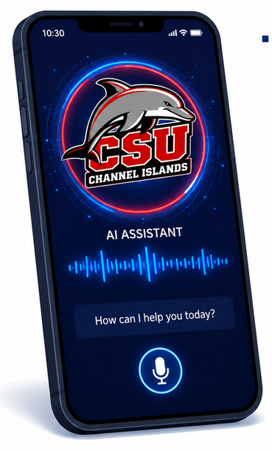
AI is starting to be everywhere…
Applied AI automates all kinds of things
Search engines
Route planning, e.g. maps, traffic..
Logistics, e.g. packages, inventory
Medical diagnosis
Automated diagnosis
Automated help desks
Spam/fraud detection
Smarter devices, e.g. cameras
Product recommendations
Lots more!

Slide 29
Vision / Perception: Seeing the World
Computer vision lets AI interpret visual input
Object recognition: identify what is in an image
Scene understanding: interpret relationships among objects
Tracking: follow objects across time
Visual grounding: connect images to language and action
Used in:
autonomous vehicles
medical-image diagnosis
robotics
surveillance and safety systems
Key idea: Perception turns raw sensor data into information an agent can use to act.
Notes:
Show videos

Slide 30
State of the Art — What AI Can Do Today
Perception & Language
Object recognition: error rate 28% (2010) → 2% (2017) — beats humans
Speech recognition: word error rate 5.1%, matching human performance (2017)
Machine translation: 100+ languages, 99% of humans' native tongues
Question answering (SQuAD): F1 score 95, exceeds human benchmark
Reasoning & Decision Making
Chess (Deep Blue, 1997), Go (AlphaGo, 2016), Poker, StarCraft II, Dota 2
Autonomous planning: NASA Remote Agent; DART saved 30 years of DARPA investment
Robotic vehicles: Waymo at 10M miles; autonomous drones delivering blood in Rwanda
Science & Medicine
AI ≥ expert doctors at diagnosing Alzheimer's, metastatic cancer, skin disease
Human-AI partnerships outperform either alone (LYNA: 99.6% accuracy)
AlphaFold: protein structure prediction — decades-old biology challenge solved
Deep learning models detect extreme weather patterns buried in climate data
Notes:
Perception and language: AI made major gains in object recognition, speech recognition, translation, and question answering. On some narrow benchmarks, systems matched or exceeded human performance.
Reasoning and decision-making: AI achieved strong results in chess, Go, poker, StarCraft II, and Dota 2. It also supported real-world planning through NASA’s Remote Agent, DART logistics, self-driving vehicles, and autonomous drones.
Science and medicine: AI matched specialists on some diagnostic tasks and helped analyze large scientific datasets. The LYNA example showed that human–AI teams can outperform either working alone.
The key point is that these systems are highly capable in specialized tasks, but they are not examples of broad human-level intelligence.

Slide 31
Risks and Benefits of AI
Benefits
Risks
Free humanity from menial, repetitive work
Dramatically increase production of goods and services
Accelerate scientific research: cures, climate solutions
Demis Hassabis: 'First solve AI, then use AI to solve everything else'
Medical AI already equals or exceeds specialists in several diagnostics
AI helps 100M+ people daily with navigation, translation, recommendations
Lethal autonomous weapons: scalable, no human supervision required
Mass surveillance: speech/vision AI enables real-time monitoring at scale
Biased decision making: parole, loans — reflecting and amplifying societal bias
Employment disruption: shifts wealth from labor to capital
Safety-critical failures: self-driving fatal accidents; formal verification gaps
Cybersecurity: RL-powered phishing/blackmail; automated malware
Notes:
Benefits: AI can reduce repetitive work, increase productivity, and accelerate research in areas such as medicine and climate science. It already supports daily services including navigation, translation, recommendations, and specialized medical diagnosis.
Risks: The same capabilities can support autonomous weapons, mass surveillance, biased decisions, employment disruption, and cyberattacks. Failures are especially serious when AI is used in safety-critical systems such as transportation.
The key point is that AI is a dual-use technology. Its impact depends on how systems are designed, governed, and aligned with human goals.
Notes: RL-Powered
RL-powered means reinforcement learning-powered.
It refers to an AI system that learns which actions work best through rewards and penalties. The system tries actions, observes the results, and adjusts its behavior to increase future rewards.
In this slide, “RL-powered phishing/blackmail” means reinforcement learning could be used to automatically test and improve attack strategies, such as choosing messages, timing, or targets that produce the highest success rate.

Slide 32
HLAI, AGI, ASI, and the Gorilla Problem
HLAI
AGI
ASI
Human-level AI: learn to do anything a human can do
Artificial general intelligence: broad abilities across tasks
Artificial superintelligence: far surpasses human ability
Capability increases
The Gorilla Problem
A less capable species may have little control over its future once a more capable intelligence exists.
Key idea: objective misalignment is one risk; loss of control to a more capable intelligence is another.
COMP 469 · Chapter 1
Notes:
PowerPoint Teacher Footnotes
HLAI refers to AI that can learn to perform the broad range of intellectual tasks humans can perform. AGI describes similarly general intelligence that can transfer knowledge and adapt across different tasks. These terms are closely related rather than sharply separated.
ASI goes beyond human-level intelligence and would greatly surpass human abilities in areas such as learning, planning, strategy, and scientific discovery. Chapter 1 presents ASI as a possible future development, not a description of current AI.
The gorilla problem illustrates the risk of losing control to a more capable intelligence. Gorillas have little control over decisions humans make about their environment and future. Similarly, humans might have limited influence over a system that becomes far more capable than we are.
This differs from the King Midas problem. King Midas concerns a system correctly pursuing an incorrectly specified objective. The gorilla problem concerns humans losing control because the system is more capable.
Chapter 1 emphasizes that superintelligent AI would be designed by humans, so loss of control would represent a design failure. Safer systems should remain uncertain about human objectives, accept correction, ask for clarification, and permit themselves to be switched off.
Key takeaway: Objective misalignment and loss of control are related but distinct risks. Greater capability makes careful objective design, alignment, and human oversight increasingly important.
Section: 1.5 — Risks and Benefits of AI

Slide 33
Natural Language: Communication and Understanding
Speech Technologies
Automatic speech recognition: speech → text
Text-to-speech synthesis: text → spoken language
Dialogue systems: maintain an interactive conversation
Language-Processing Technologies
Question answering: interpret a question and produce a relevant answer
Machine translation: convert meaning between languages
Language understanding: connect words to context and world knowledge
Language AI Requires More Than Words
Language + Knowledge + Reasoning + Learning
Key idea: Successful language processing requires syntax, meaning, context, and knowledge of the world.

Slide 34
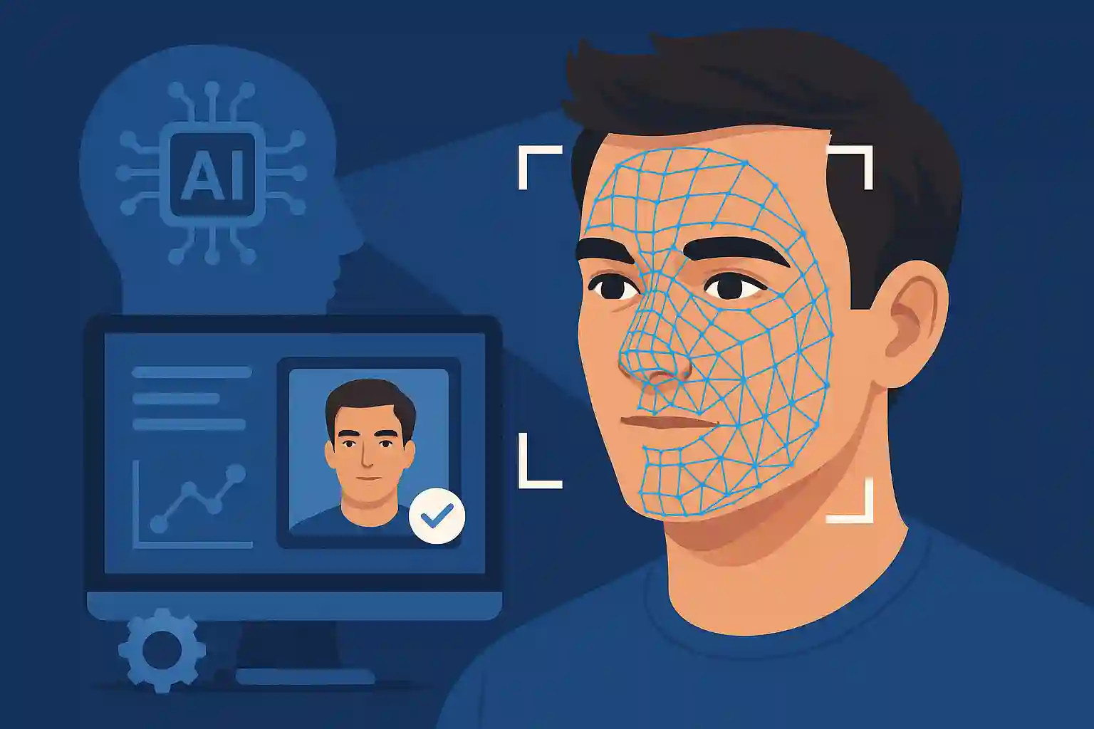
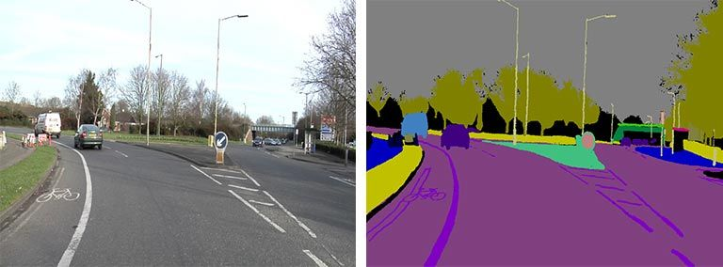
PIXELS → INFO/DECISION
Face detection and recognition
Semantic Scene Segmentation

Slide 35
Chapter 1 Summary
AI's goal: build agents that act rationally — maximizing expected performance given an objective.
Four historical approaches: acting/thinking humanly vs. rationally. The rational agent approach dominates.
Value alignment: machines pursuing a fixed objective can cause harm; future AI must handle uncertain objectives.
Seven founding disciplines: Philosophy, Mathematics, Economics, Neuroscience, Psychology, Linguistics, CS.
History follows cycles: enthusiasm → failure → new approach. Deep learning is the latest revolution.
State of the art: AI now matches or exceeds humans in perception, translation, diagnosis, and complex games.
Risks are real: autonomous weapons, surveillance, bias, employment disruption, misaligned superintelligence.

Slide 36
Questions?
COMP 469 · Artificial Intelligence · CSU Channel Islands

